Slide 1
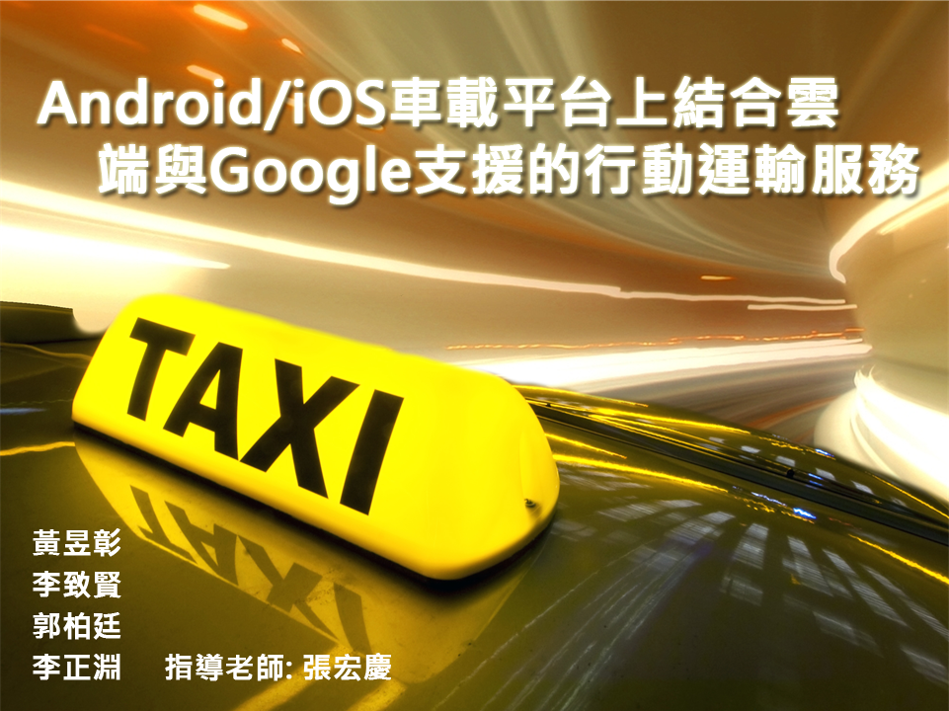

Slide 2
Outline
Conception
App & Technique
Passenger
Driver
New Features
Speech recognition
Notification
RDS-TMC
System Construction

Slide 3
Conception

Slide 4

Passenger
Convenient
Security
Humanization Design
More Opportunity

Slide 5
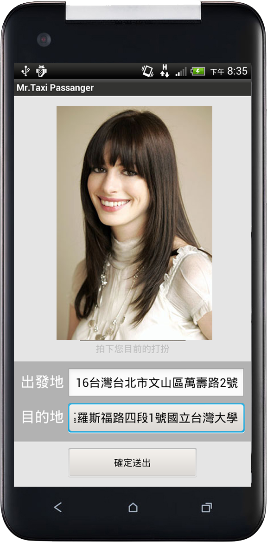
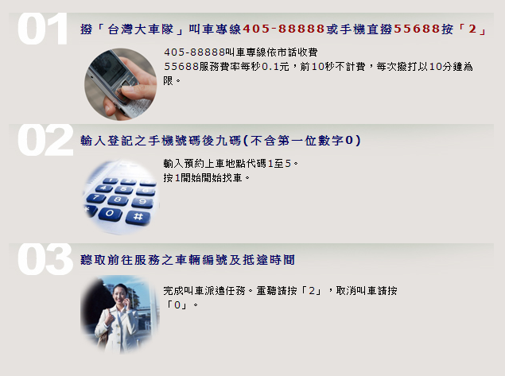
Simplify
╳
Now
We want

Slide 6
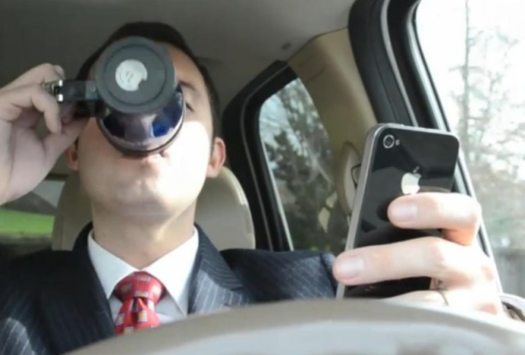
Driver
More Passenger
Route Planning
Video Recorder
Less Mechanism

Slide 7
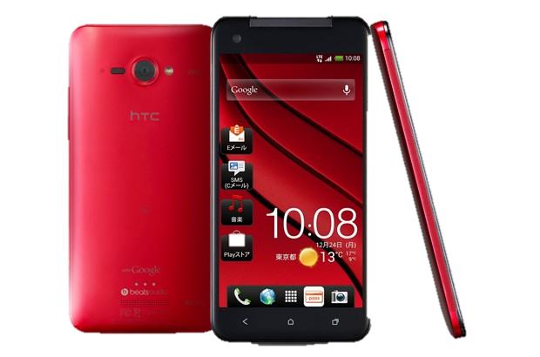
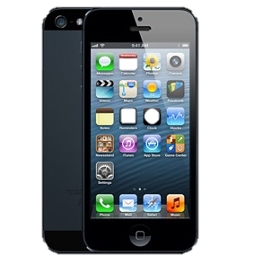
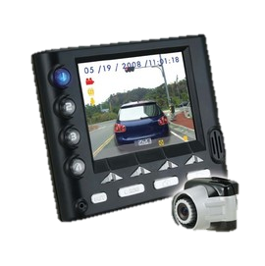
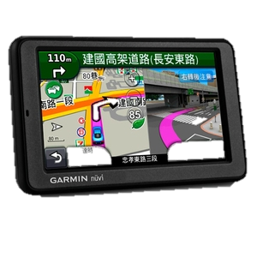
Combination
+

Slide 8
Passenger
Driver
More Opportunity
Convenient
Security
Humanization Design
More Passenger
Route Planning
Video Recorder
Less Mechanism

Slide 9

Interaction
×
iOS
Android

Slide 10
App & Technique

Slide 11
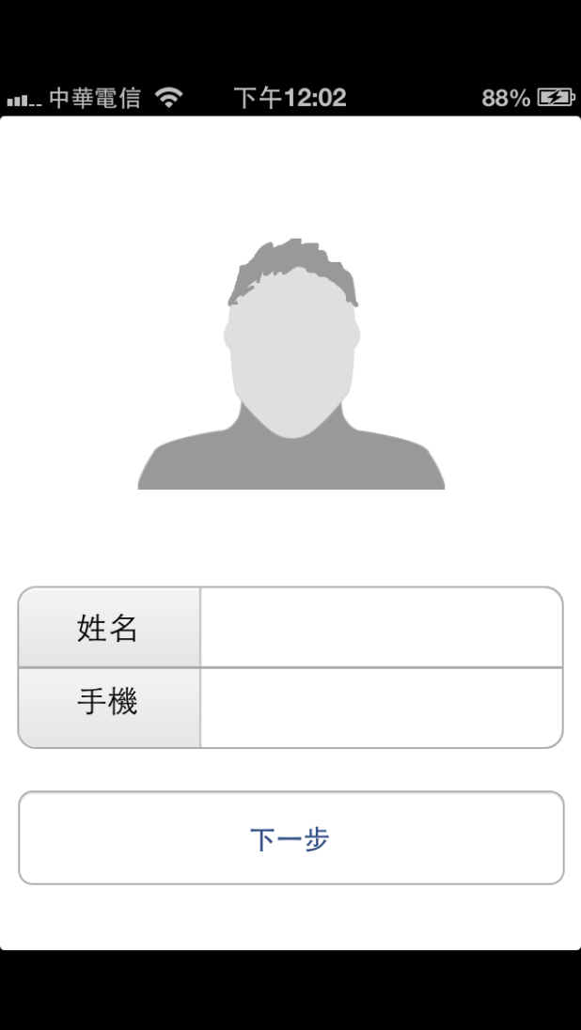
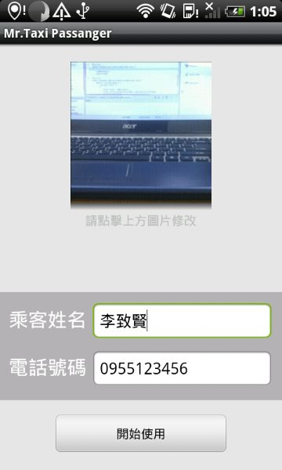
Passenger
Register

Slide 12
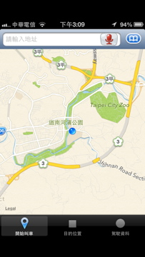
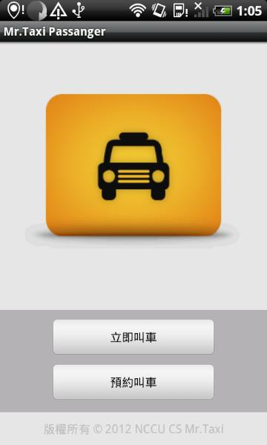
Passenger
Function

Slide 13
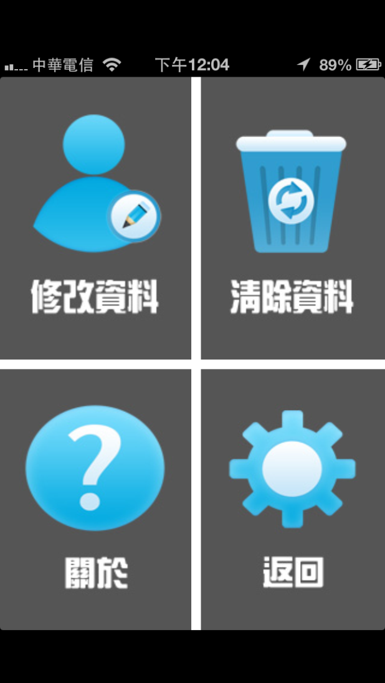
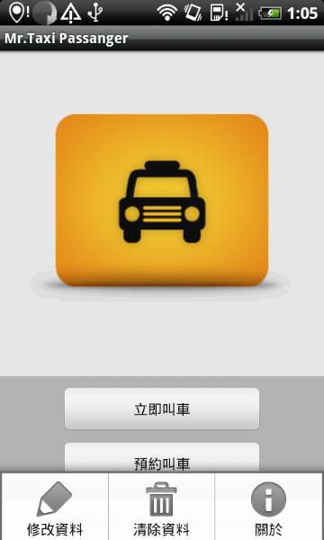
Passenger
Menu

Slide 14
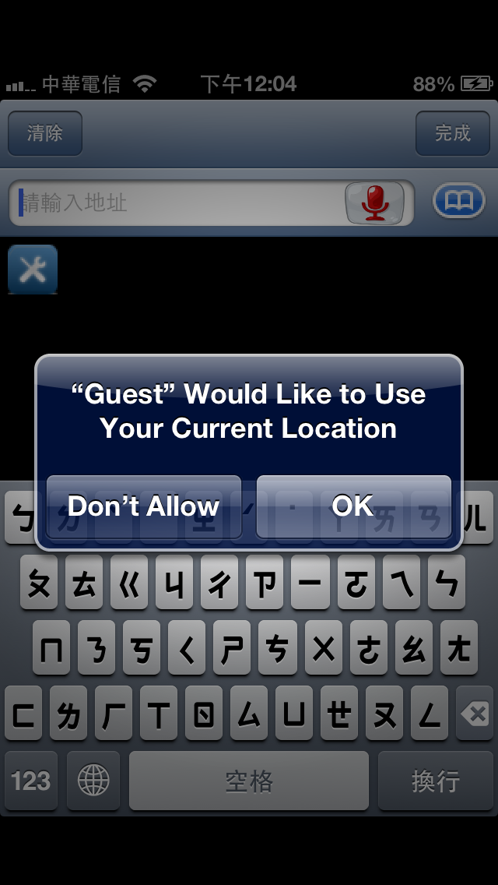
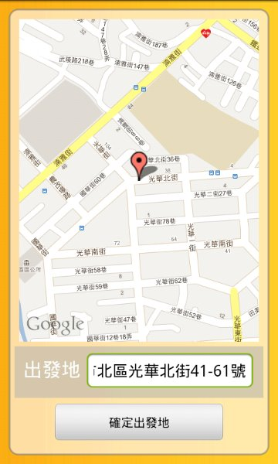
Passenger
Starting point

Slide 15
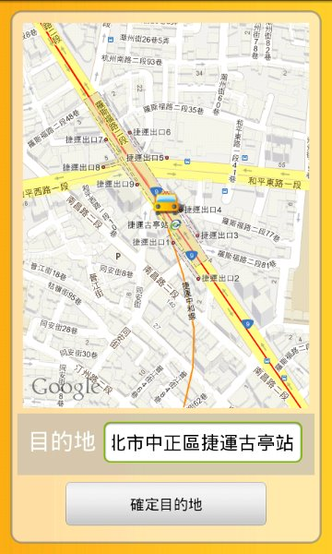
Passenger
Destination

Slide 16
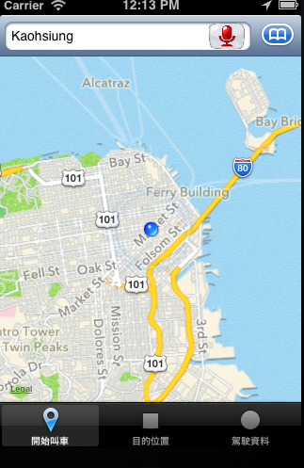
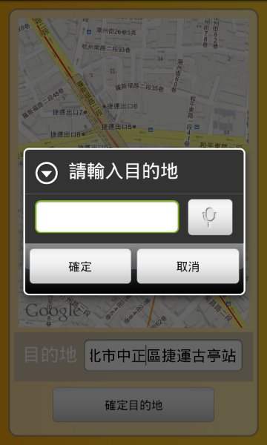
Passenger
Input

Slide 17
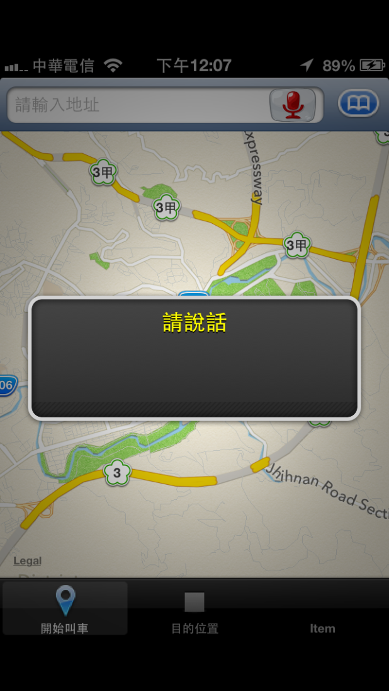
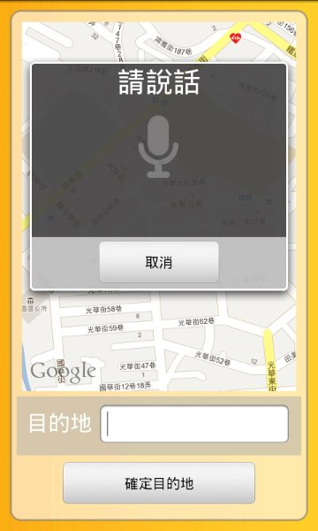
Passenger
Speech recognition

Slide 18
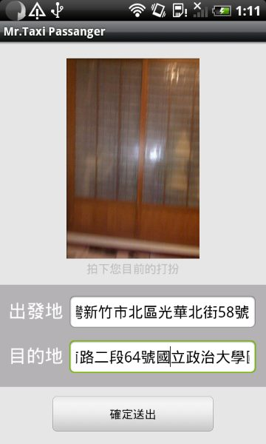
Passenger
Confirm

Slide 19
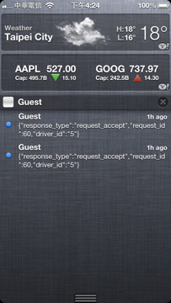
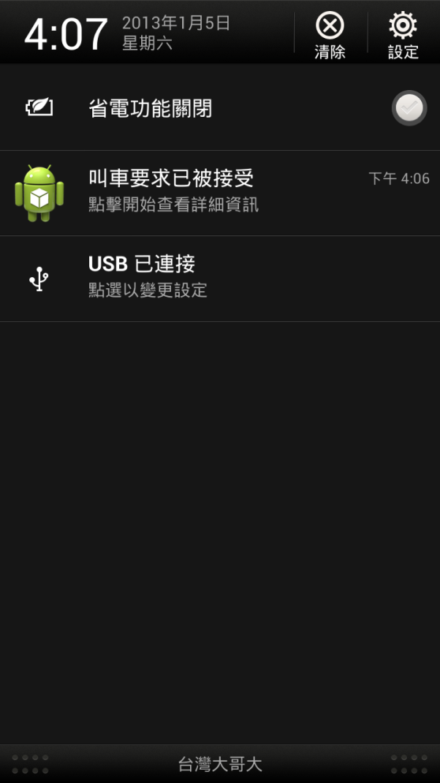
Passenger
Request Accepted

Slide 20
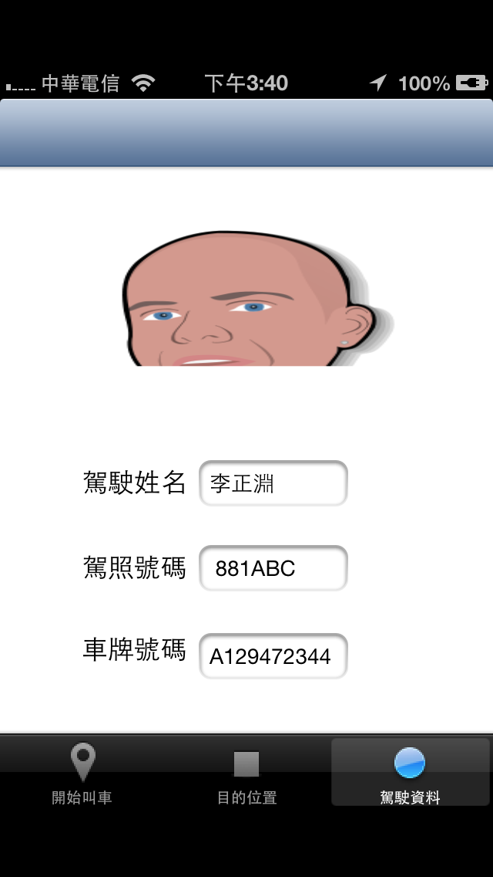
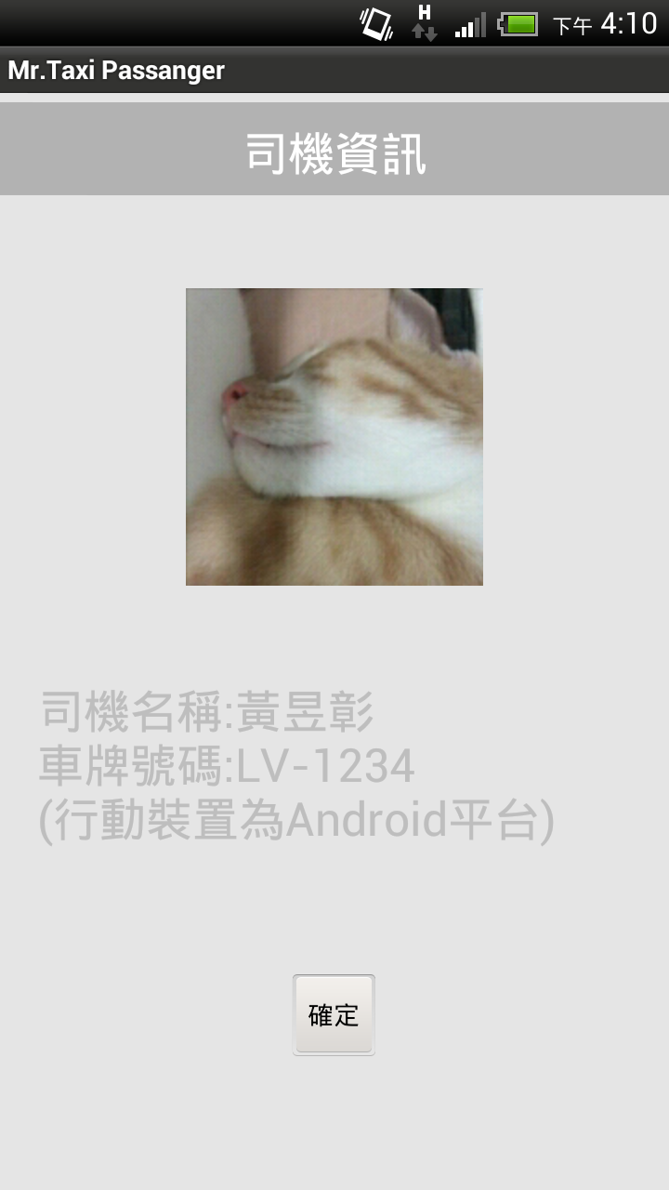
Passenger
Request Accepted

Slide 21
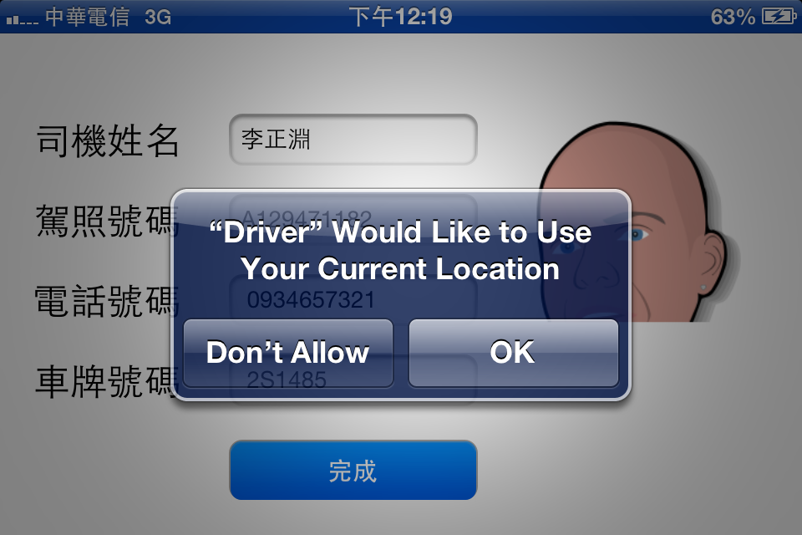
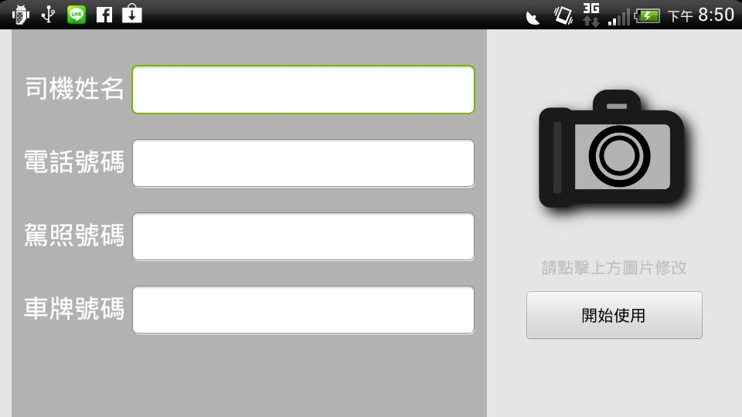
Driver
Register

Slide 22
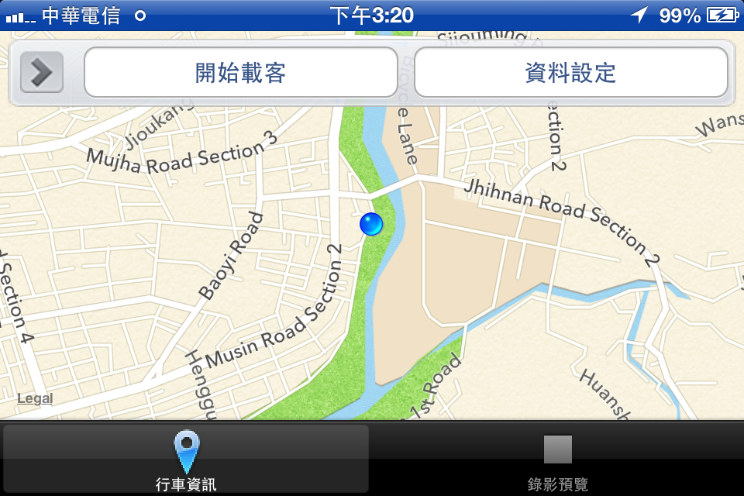
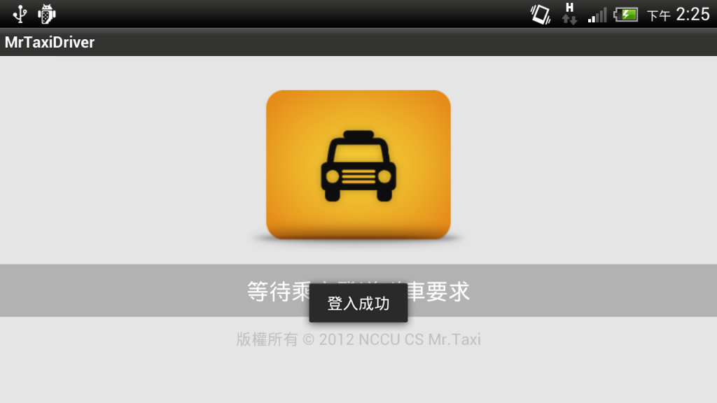
Driver
Sign in

Slide 23
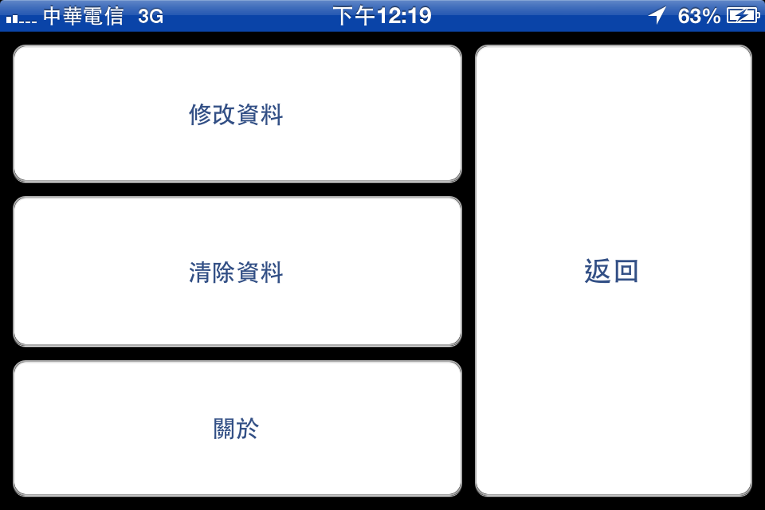
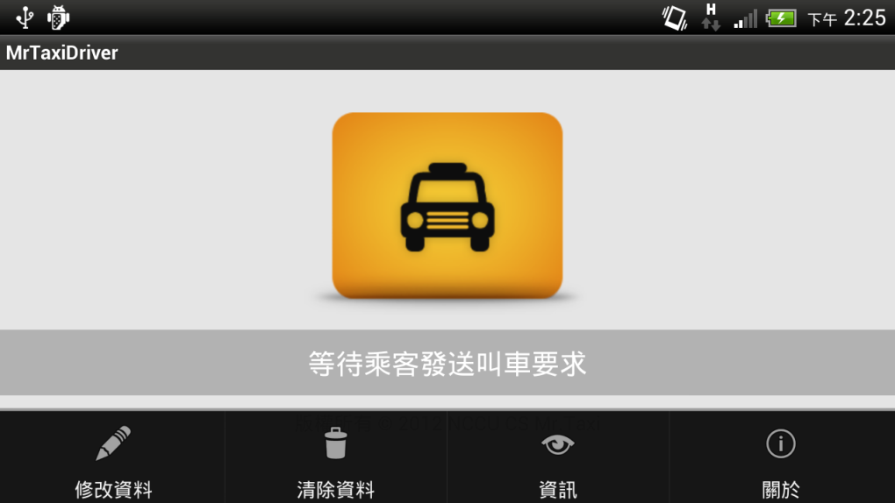
Driver
Menu

Slide 24
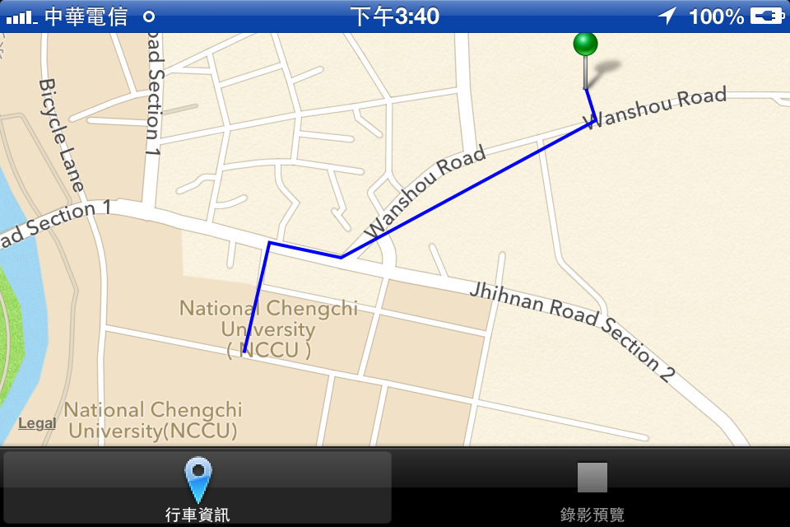
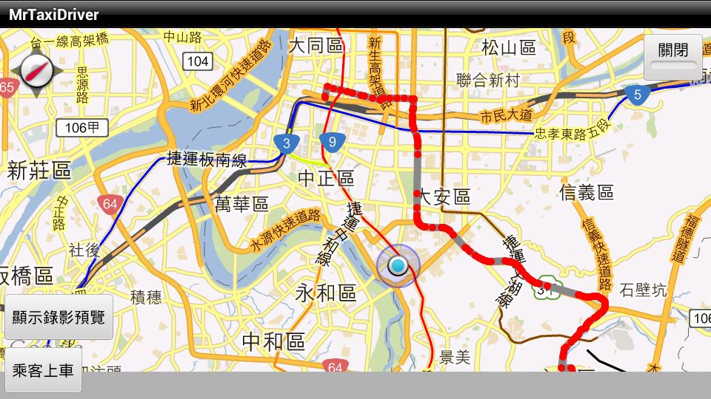
Driver
Route Planning

Slide 25
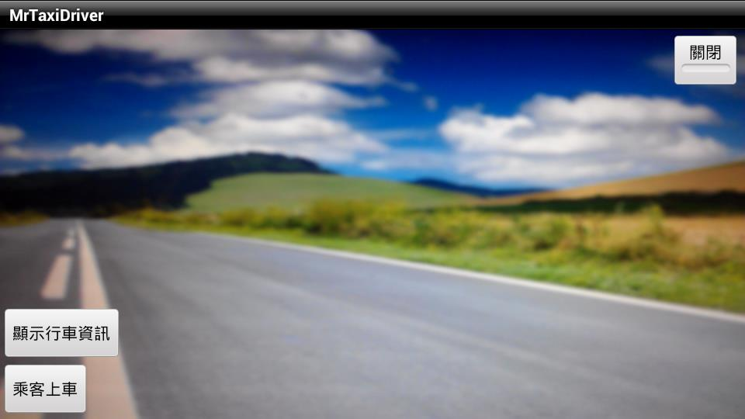
Driver
Video Recorder

Slide 26
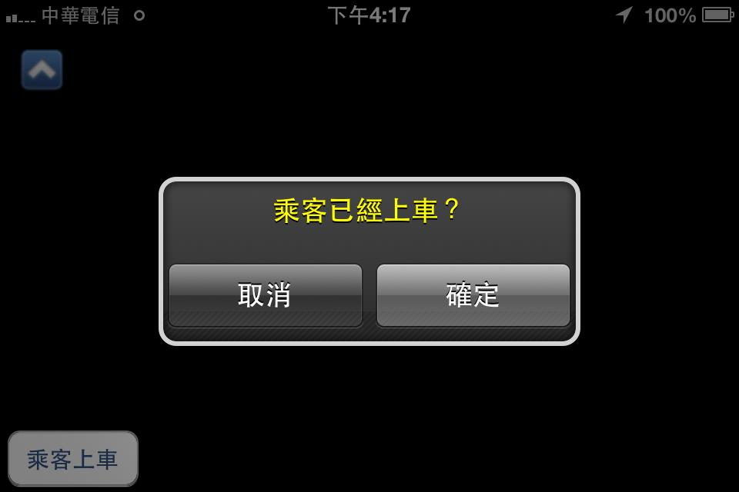
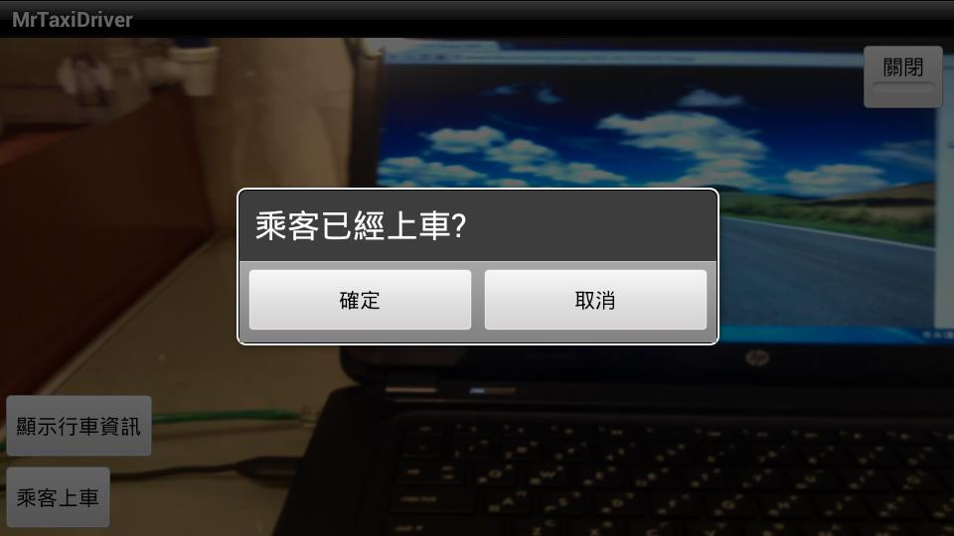
Driver
Arrive

Slide 27
New Features

Slide 28
Speech recognition
Android
Android API
iOS
Google Speech Recognition API

Slide 29
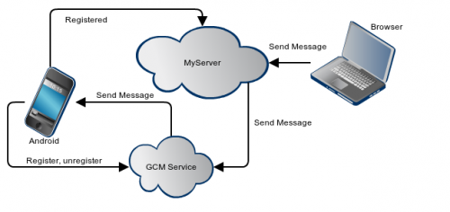
Notification
Android
GCM

Slide 30
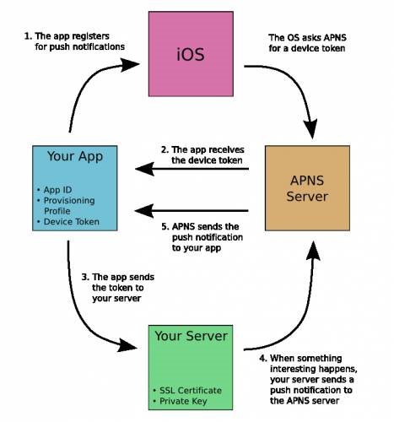
Notification
iOS
APNS

Slide 31
Route Planning
RDS-TMC

Slide 32
System Construction

Slide 33
致賢

Slide 34
Thanks

